Slide 1
Lexical Analysis Phase

Slide 2
Al-Zahraa El-Sallakh
Rawan El-Shishtawy
Salma El-Khawaga
Maha El-Gendy
Team
Members

Slide 3
Symbols
Operators
Invalid Character
Identifiers
Keywords

Slide 4
Sequence of characters
Token
Only digits
Word
Constant
Keyword
Identifier
Valid
Invalid

Slide 5
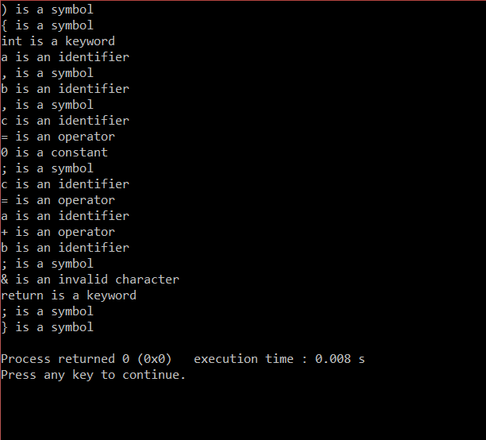

Slide 6
Syntax Phase

Slide 7
S
int
T
T
* int
T
+ int
T
€
Rule index= 1
Rule index= 2

Slide 8
Thank You!

